Slide 1
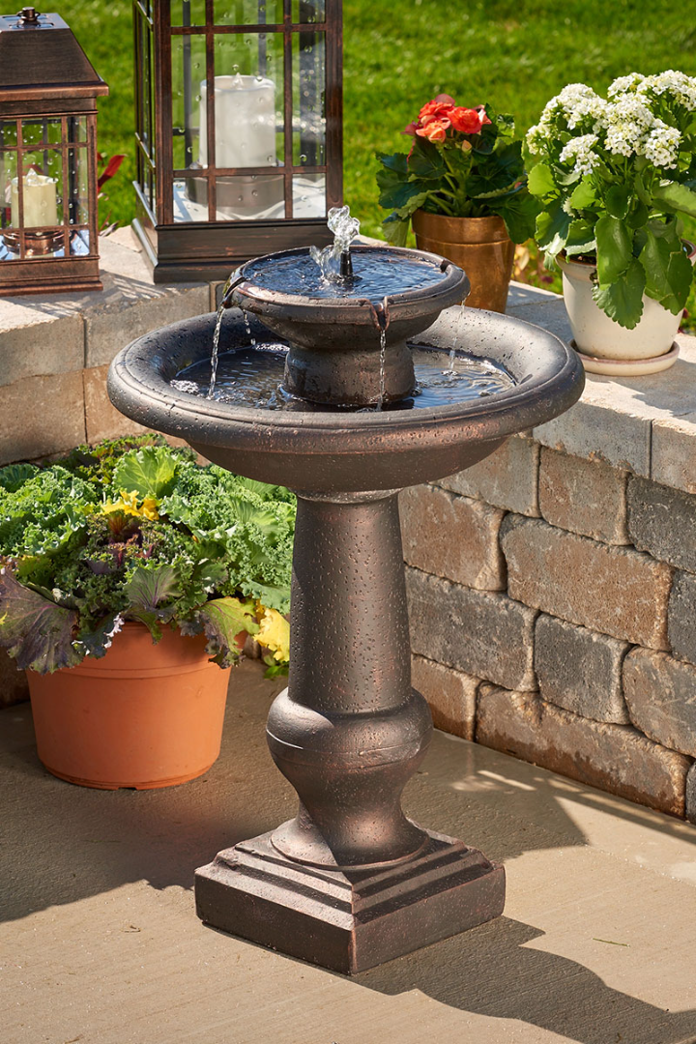
Smart Water Fountains using IOT
Upgrade your water fountains with the internet of things for a smarter, more sustainable future.
Notes:
1

Slide 2
What are smart water fountains?
Sustainable 🌱
User-Friendly 🙌
Cost-effective 💰
Designed with eco-friendly materials and sensors that track water usage, smart water fountains help reduce waste and conserve water resources.
Intuitive interfaces make it easy to find and use the water fountain. Plus, real-time data on water quality keeps users informed of potential risks.
Save money on utilities and maintenance costs by automatically tracking usage data and detecting malfunctions before they occur.
Notes:
2

Slide 3
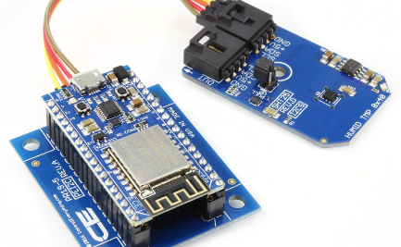
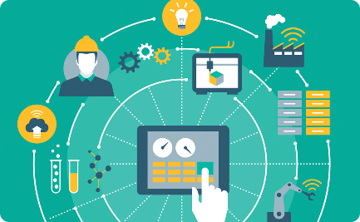
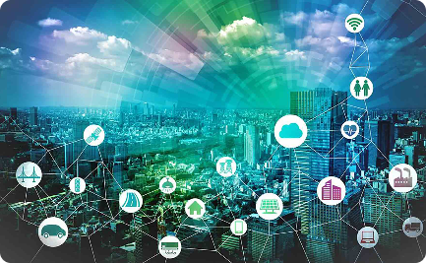
The benefits of integrating IOT
Data Collection 📊
Remote Monitoring 🌍
Smart Control 🤖
Real-time data collection helps monitor water usage and detects potential malfunctions, reducing water waste and operational costs.
Use remote monitoring and predictive maintenance to detect issues before they occur, and keep repair costs down.
Integrate iot connectivity to allow for remote control of fountains, enabling easy management and monitoring.
Notes:
3

Slide 4
Features of smart water fountains
Smart Sensors
Track usage data and detect potential malfunctions in real-time for better efficiency and cost savings.
Touchless Controls
2
Improve sanitation and reduce the spread of germs with touchless controls and automatic dispensing.
3
Water Quality Monitoring
Track water quality and detect potential hazards before they become an issue with smart sensors and real-time data collection.
Notes:
4

Slide 5

How IOT is integrated
Smart Sensors and Controls
2
Data Analysis
3
Cloud Connectivity
Data analysis tools can provide real-time insights into usage patterns and maintenance requirements, saving time and reducing costs.
Integrating sensors and controls into traditional hardware enables real-time data collection and remote management via the internet of things.
Connecting fountains to the cloud allows for easy management and monitoring of multiple locations from a single platform.
Notes:
5

Slide 6

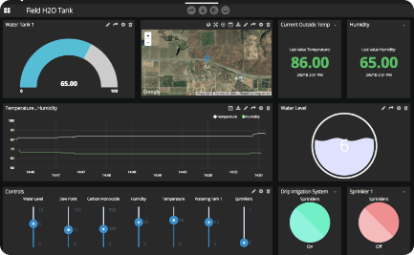
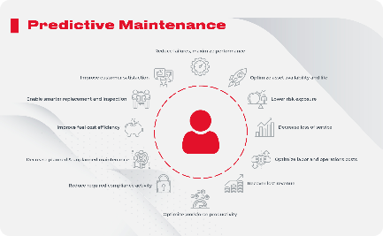
Data collection and analysis
Dashboard Reporting
Predictive Maintenance
Usage Analytics
Track usage patterns and analyze data on water consumption, temperature, and sanitation to improve operating efficiencies and reduce costs.
Use data analysis tools to identify potential issues before they become major problems, and provide predictive maintenance to keep fountains running smoothly.
View data in real-time via a customizable dashboard interface, providing insights into performance metrics and usage patterns.
Notes:
6

Slide 7
Impact on environment and cost
Environmental Impact ♻️
Reduce water waste and environmental impact with water conservation and eco-friendly materials, while also increasing the lifespan of fountain hardware and reducing waste.
Cost Savings 💰
2
Save money on utilities and maintenance costs by using real-time data collection and predictive maintenance to detect malfunctions before they become costly problems.
3
Improved User Experience 👍
Boost user satisfaction with touchless controls, water quality monitoring, and improved operational efficiency, leading to increased productivity and overall satisfaction.
Notes:
7

Slide 8
Conclusion and future possibilities
Improved Sustainability 🌱
Increased Cost Savings 💸
Future Innovations 🚀
The possibilities for smart water fountains remain endless, including real-time usage analytics and cloud-connected monitoring.
By using smart water fountains and iot technology, we can continue to improve sustainability and reduce environmental impact across various industries, from parks to schools to corporate campuses.
Real-time data collection and predictive maintenance provide the opportunity to reduce operational costs and improve bottom-line growth.
Notes:
8

Slide 9
Blueprint for Smart Water Fountains
Smart water fountains are a new and innovative approach to traditional drinking fountains. They use advanced technology to monitor water quality in real-time, provide customizable water temperature options, and can be integrated with smart devices. They offer many advantages over traditional fountains and have the potential to revolutionize our public spaces.
Benefits of Smart Water Fountains
END
Encouraging Hydration and Improving Public Health
Reducing Water Wastage and Promoting Sustainability
Enhancing User Experience with Advanced Features
Key Features of Smart Water Fountains
Real-Time Monitoring of Water Quality
Customizable Water Temperature Options
Integration with Smart Devices for User Convenience

Slide 10
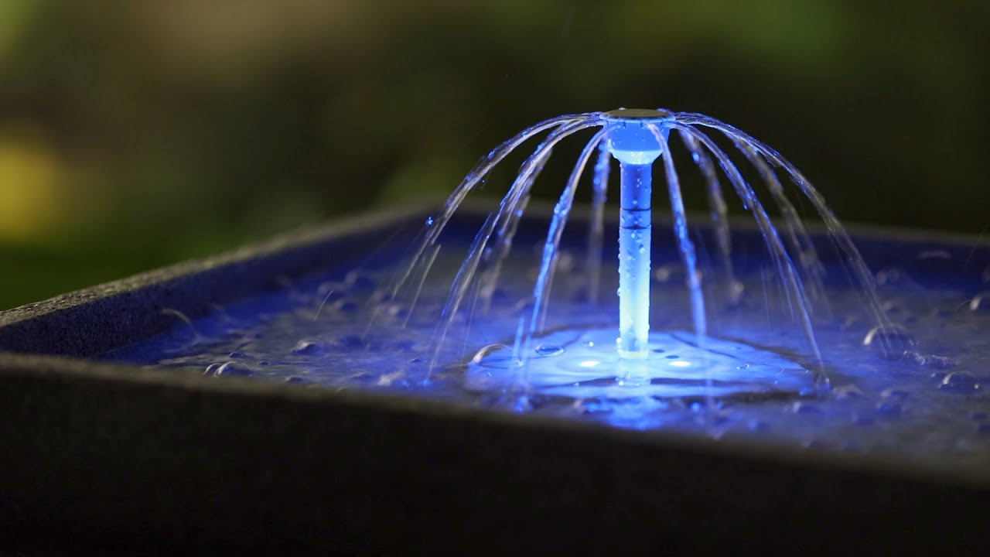
Future Developments and Challenges
Potential Advancements in Smart Water Fountain Technology
Addressing Security and Privacy Concerns
Overcoming Financial and Logistical Barriers
END

Slide 11
PROGRAM:
import time
import paho.mqtt.client as mqtt
def get_water_level():
return random.uniform(0.0, 100.0)
def get_temperature():
return random.uniform(0.0, 40.0)
def get_ph_level():
return random.uniform(0.0, 14.0)
broker_address = "mqtt.eclipse.org"
port = 1883
topic = "smart_water_foundation"
client = mqtt.Client()
client.connect(broker_address, port)
try:
while True:
# Get sensor data
water_level = get_water_level()
temperature = get_temperature()
ph_level = get_ph_level()
END

Slide 12
# Create JSON payload
payload = {
"water_level": water_level,
"temperature": temperature,
"ph_level": ph_level
}
# Publish data to the broker
client.publish(topic, str(payload))
# Print for debugging (optional)
print(f"Published: {payload}")
# Delay for a while (adjust as needed)
time.sleep(10) # e.g., every 10 seconds
except KeyboardInterrupt:
client.disconnect()
END

Slide 13
OUTPUT:
Published: {'water_level': 43.765681607967534, 'temperature': 35.28613649094769, 'ph_level': 2.834535224079818}
END
These lines indicate that the script has generated simulated sensor data and published it tothe MQTT broker. The data is in the form of a dictionary containing water level, temperature, and pH level readings.
These values are random in this example, but in a real-world application, they would be coming from actual sensors.

Slide 14
END
END

